Slide 1

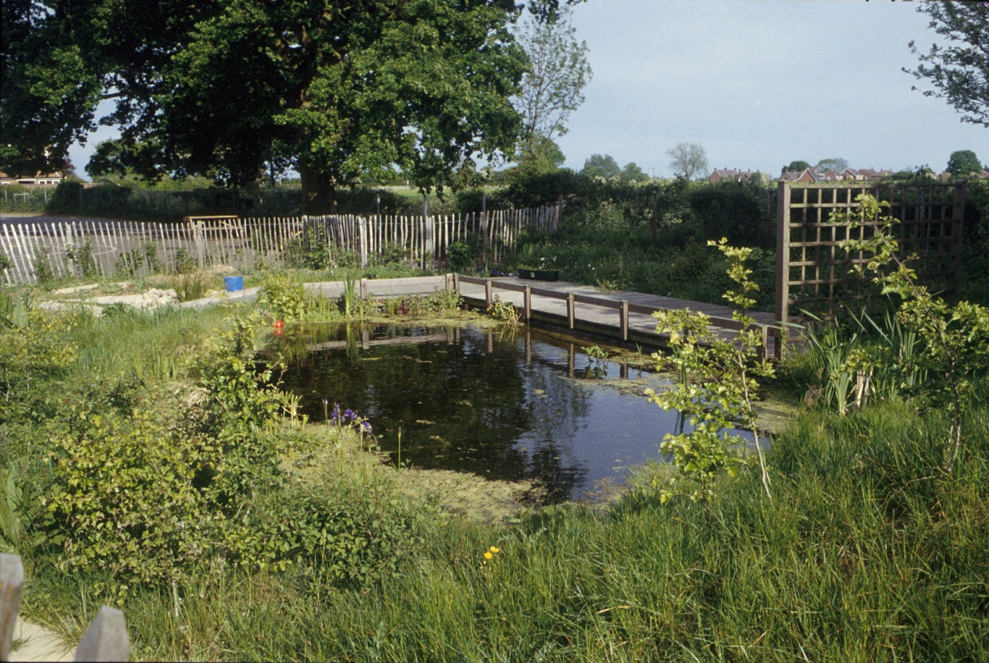
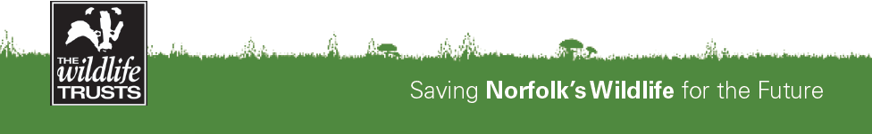
The Norfolk Wildlife Trust is
Visiting your School
Saving Norfolk’s Wildlife for the Future
Saving Norfolk’s Wildlife for the Future

Slide 2
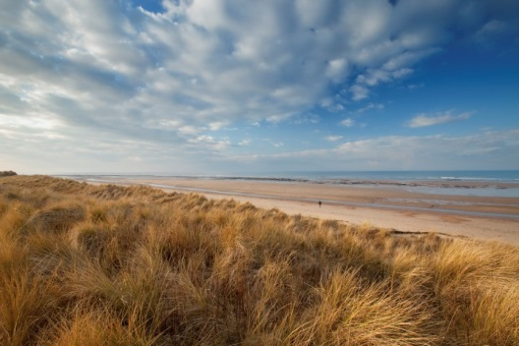
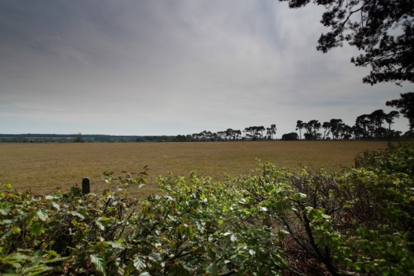
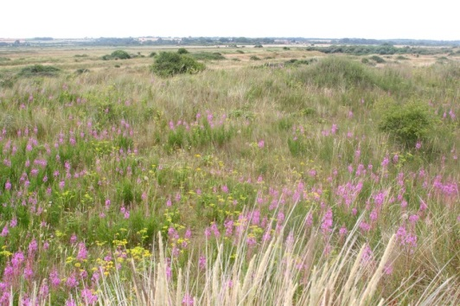
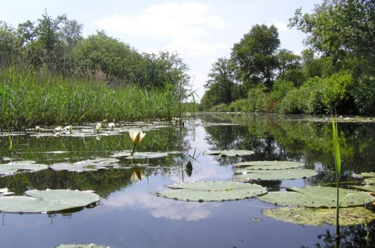
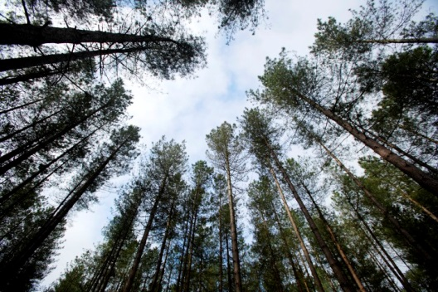
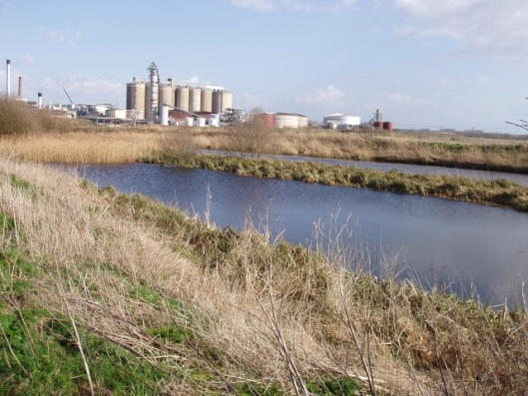
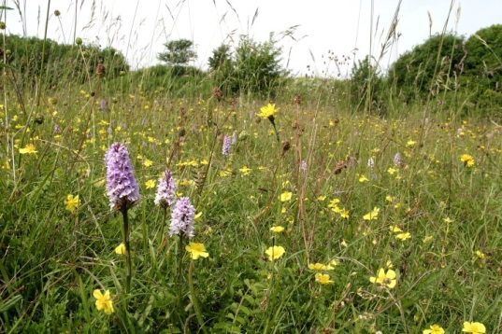
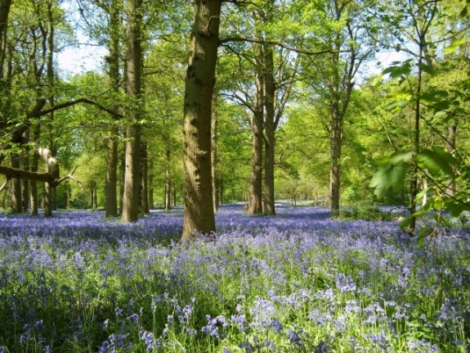
A bit about Norfolk Wildlife Trust…
We protect more than 50 nature reserves across Norfolk for wildlife and people.
Photo: Richard Osbourne
Photo: Richard Osbourne
Photo: Tasha North
Photo: Richard Osbourne
Photo: Ray Jones
Photo: Wildstock 2007
Photo: Russell Baylin
Photo: Nick Carter
Saving Norfolk’s Wildlife for the Future
Saving Norfolk’s Wildlife for the Future
Notes:
Different animals and plants need different sorts of places to live. We try to look after as many different habitats as we can. Each with their own unique species. The Norfolk Wildlife Trust protect habitats including, broads, woodland, heathland and coastal dunes to name a few.

Slide 3
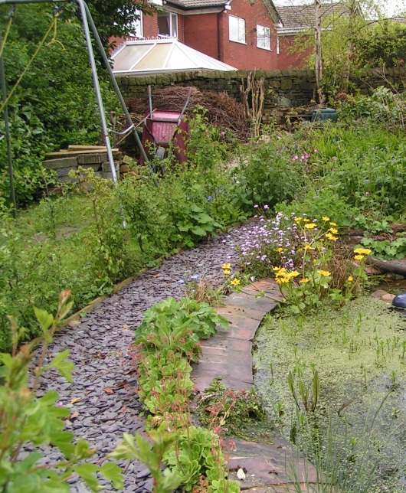
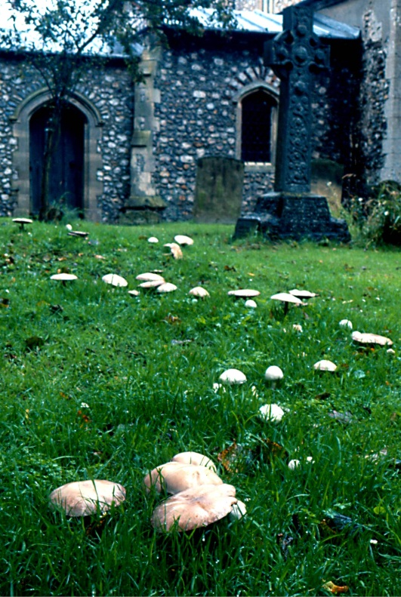
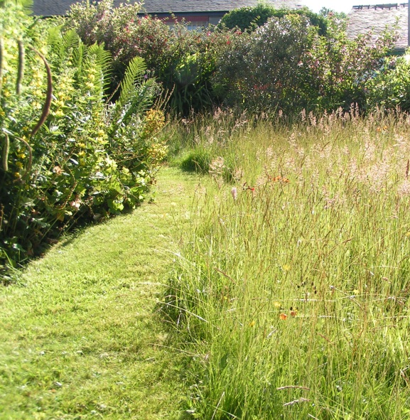
We also help to make gardens, parks, schools, churchyards, roadsides and other areas more wildlife-friendly so that habitats are joined up. We call this a “Living Landscape”.
Photo: Richard Burkmarr
Photo: Tony Leach
Photo: Richard Burkmarr
Saving Norfolk’s Wildlife for the Future
Notes:
These areas aren’t immaculately tidy, which is great for wildlife. Some grass is long, there is a pond and the species are native to Britain.

Slide 4
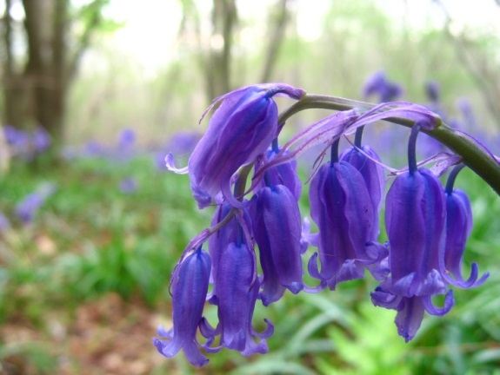
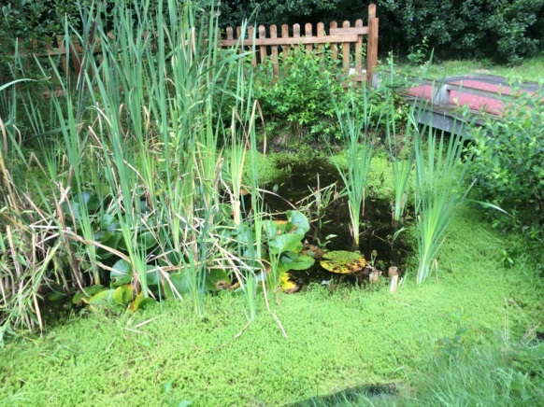
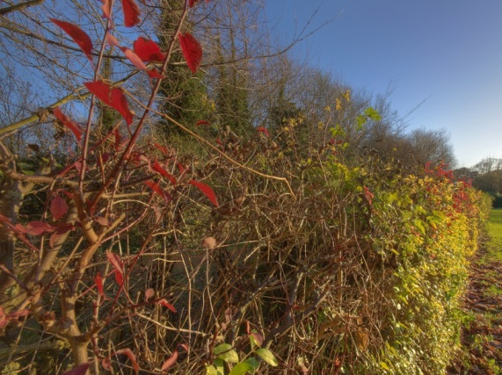
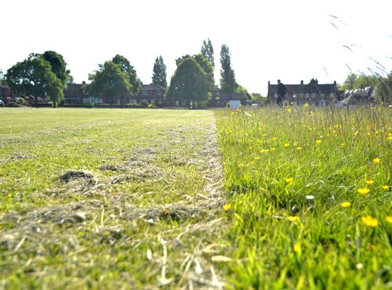
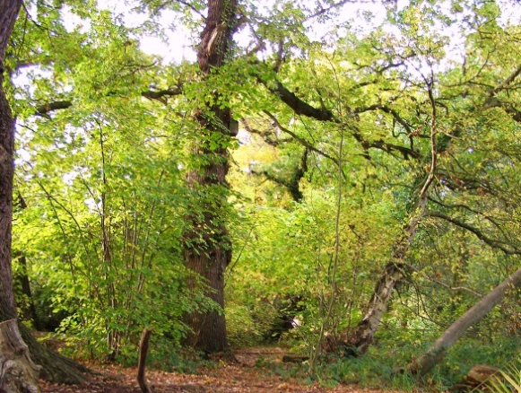
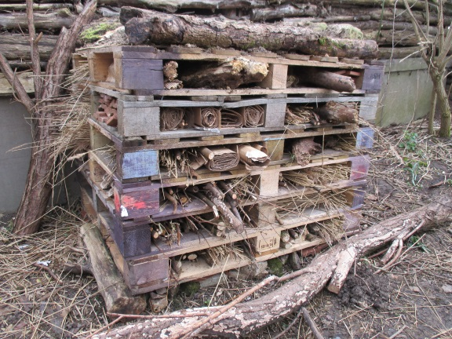
Which of these habitats do you
have at your school?
Photo: Matthew Tebbutt
Photo: Sutton Primary
Photo: Mark Burr
Wildflowers
Pond
Hedgerow
Photo: Birmingham Mail
Photo: Gemma Walker
Photo: Liz Dack
Playing field
Woodland
Minibeast hotel
Saving Norfolk’s Wildlife for the Future
Notes:
Habitats come in all shapes and sizes, from large woodlands to a small patch of flowers. How many of these habitats do you have on your school grounds?

Slide 5
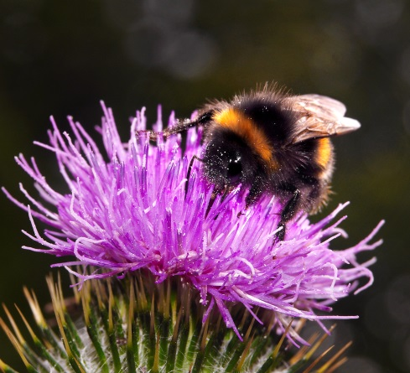
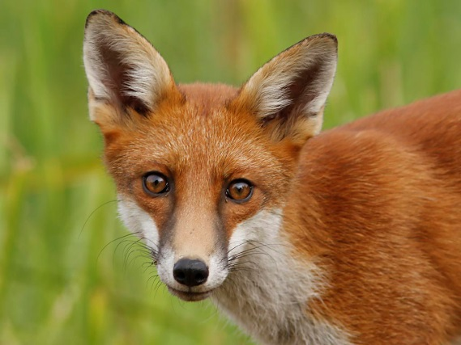
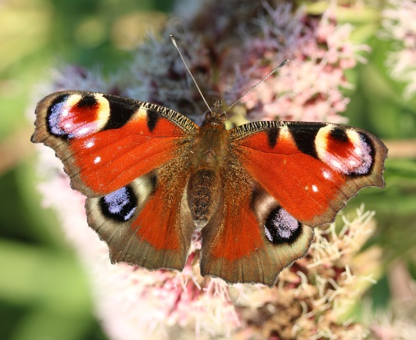
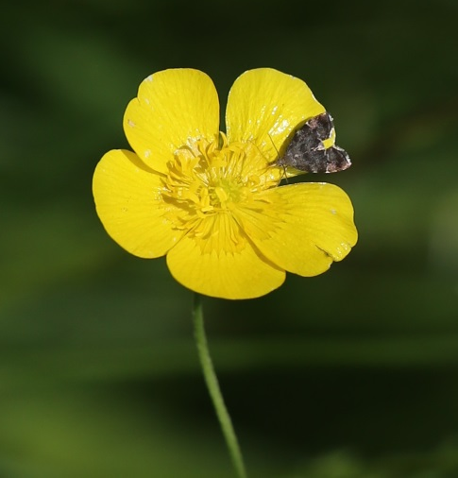
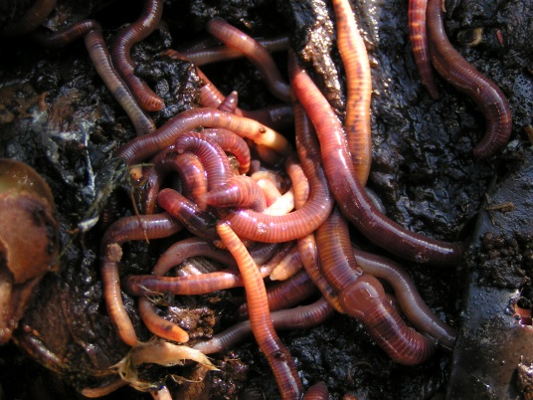
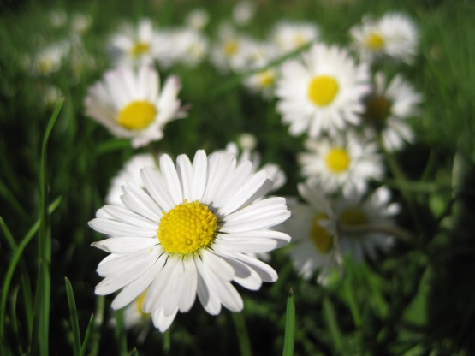
Can you name some of the species you might find on your playing field?
Photo: Brian Macfarlane
Photo: David Rose
Photo: David Goodrun
Photo: Mark Burr
Photo: Ian Davis
Photo: Liz Dack
Saving Norfolk’s Wildlife for the Future
Notes:
Your playing field is full of life, especially if some of the grass has been left to grow long. Can you name these species? Clockwise from top left: Fox, bumble bee (buff tailed), butterfly (peacock), earthworm, daisy, buttercup.

Slide 6
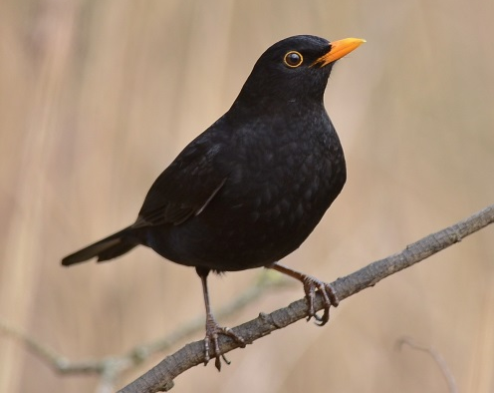
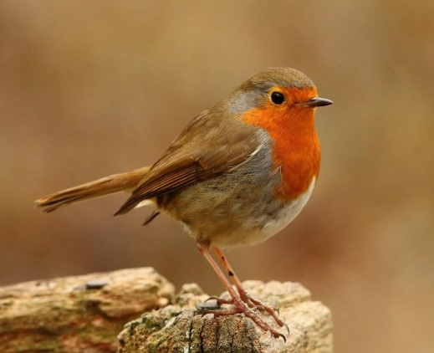

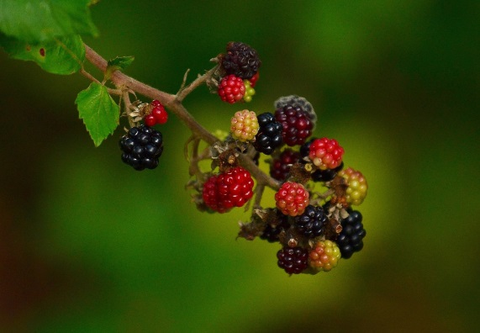
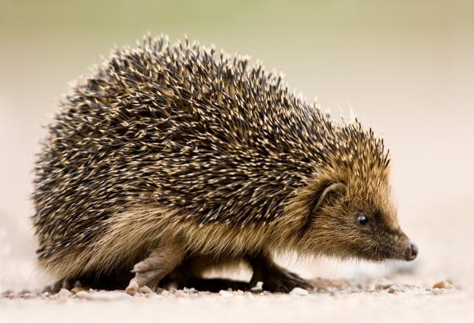
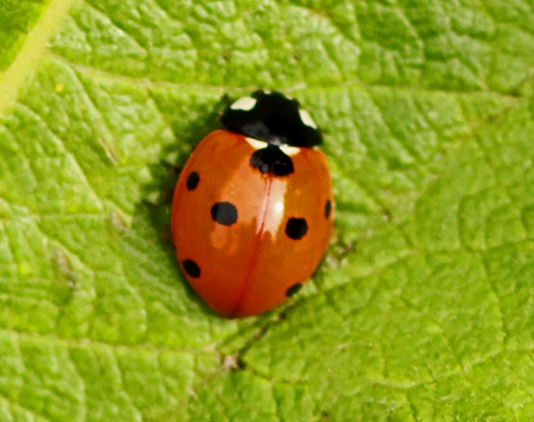
Can you name some of the
species you might find in a hedge?
Photo: Liz Dack
Photo: Leigh Gallant
Photo: Liz Dack
Photo: Peter Mallet
Photo: Howard Stone
Saving Norfolk’s Wildlife for the Future
Notes:
Hedges used to criss-cross the whole of Britain, due to the intensification of farming and the construction of towns and roads, there are far fewer today. Some of them can be hundreds of years old! Can you name these species? Clockwise from top left: Robin, blackbird, blackberries, ladybird, hedgehog.

Slide 7
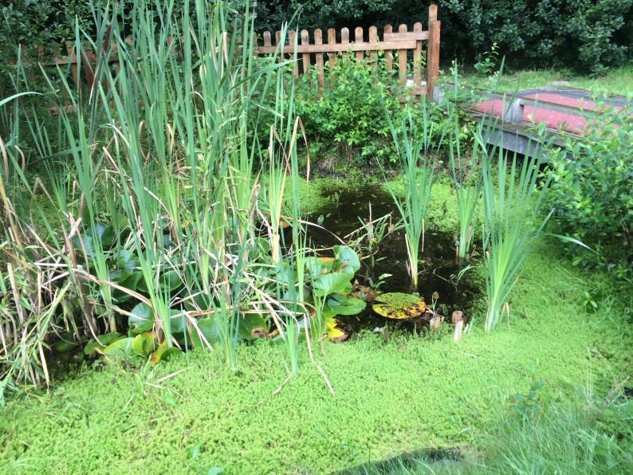
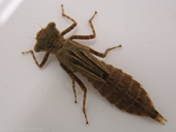

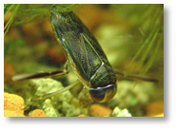
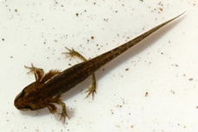
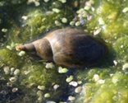
Can you name some of the
species you might find in a pond?
Photo: Jessica Reiderer
Photo: RVA News
Photo: FSC Guides
Photo: FSC Guides
Photo: Hazel Munt
Saving Norfolk’s Wildlife for the Future
Notes:
Many species of freshwater minibeasts spend most of their lives underwater as nymphs before leaving the pond as adults. Can you name some of these species? Clockwise from top left: Pond skater, dragonfly nymph, lesser water boatman, pond snail, smooth newt.

Slide 8
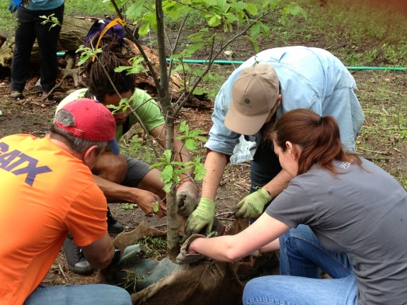
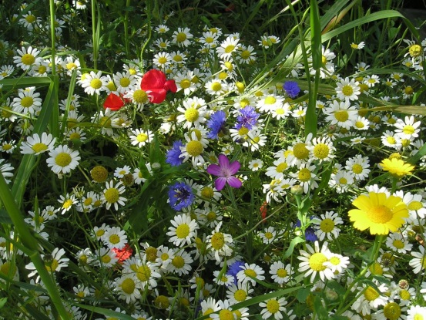
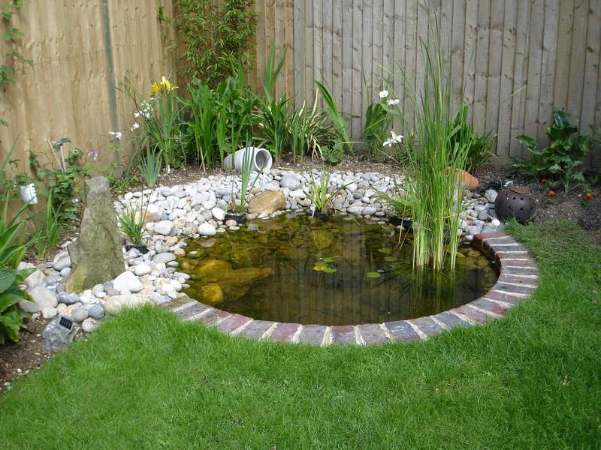
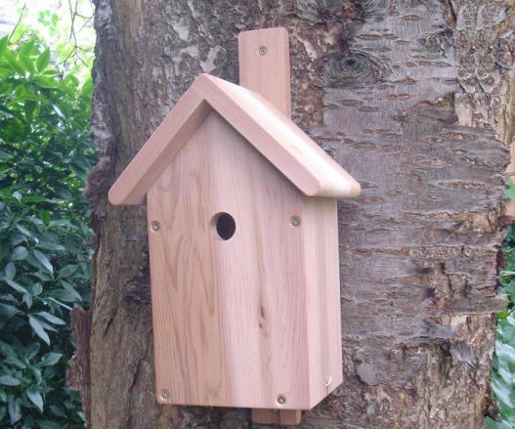
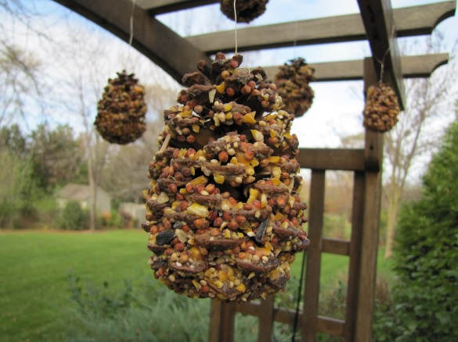

How could you make your school
a better place for wildlife?
Photo: RVA News
Photo: Wildflowers.uk.com
Photo: Pinterest
Plant trees
Plant wildflowers
Build a pond
Photo: Nature cameras
Photo: Icon Home Design
Photo: Gemma Walker
Put up bird boxes
Make bird feeders
Make a bug hotel
Saving Norfolk’s Wildlife for the Future
Notes:
Everyone can help by doing a little bit for wildlife. All of those little bits add up to make a living landscape. What things could you do around your school to help wildlife? Clockwise from top left: Plant trees, plant wildflowers, build a pond, put up bird boxes, make bird feeders, make a bug hotel. How many ideas did you come up with? Can you think of any which aren’t included on this slide?

Slide 9
These are some of the words we might use during our visit. Can you work out what they are?
1) A place where plants and animals live
H
A
B
I
T
A
T
2) An exact type of animal or plant
S
P
E
C
I
E
S
3) An area which is protected for wildlife
N
A
T
U
R
E
R
E
S
E
R
V
E
4) Something plants and animals have done over time so that they can live in their habitat
A
D
A
P
T
5) The number of different plant and animal species in an area
B
I
O
D
I
T
Y
V
E
R
S
I
Saving Norfolk’s Wildlife for the Future

Slide 10
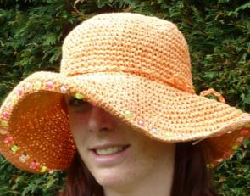
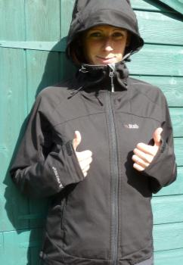
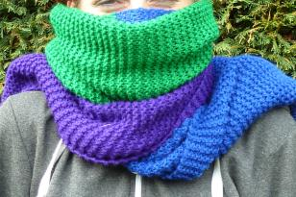
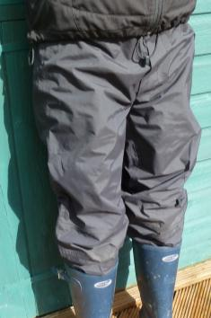
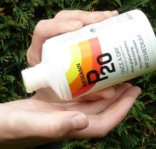
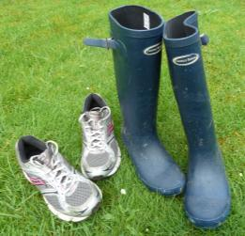
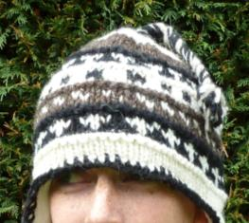
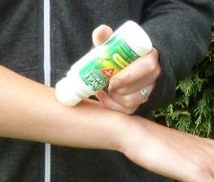
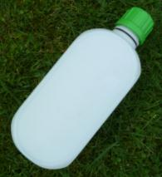
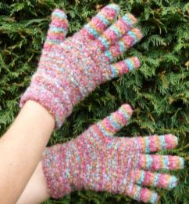
What to wear if we’re going outside
Hot and sunny weather
Whatever the weather
Sun hat
Waterproof
jacket
Cold weather
Scarf
Waterproof trousers,
quick drying trousers
or spare clothes
Sun cream
Warm
hat
A re-sealable
drink
Insect repellent
or long trousers and sleeves
Gloves
Welly boots or shoes
you can get dirty
NOT YOUR BEST SHOES!
Saving Norfolk’s Wildlife for the Future

Slide 11

What would you like to know about Norfolk’s wildlife?
Photo: Elizabeth Dack
Can you each come up with 2 questions for us?
Saving Norfolk’s Wildlife for the Future
Notes:
These don’t necessarily have to be answerable.

Slide 12

See you soon!
Photo: Copper Beech Natural Playgrounds
Saving Norfolk’s Wildlife for the Future

