Slide 1
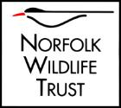
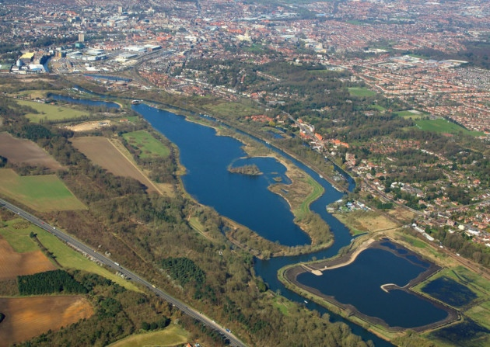
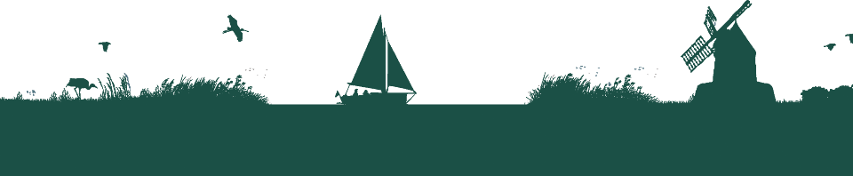
Welcome to Thorpe Marshes
Saving Norfolk’s Wildlife for the Future
Notes:
Photo: Mike Page

Slide 2
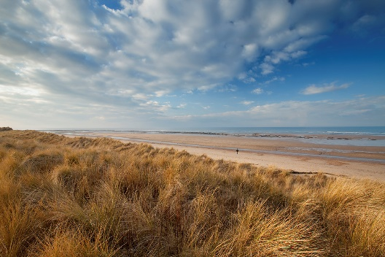
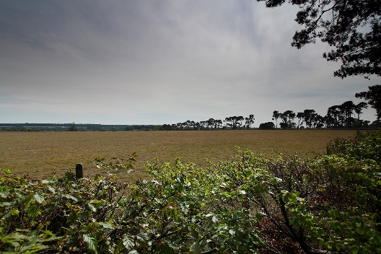
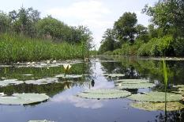
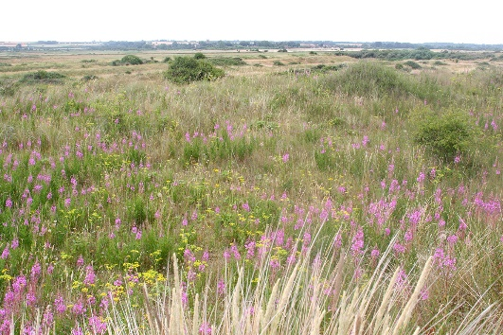
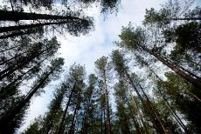
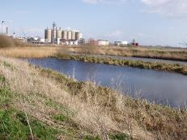
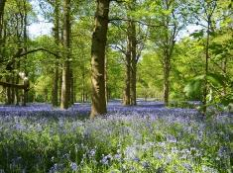
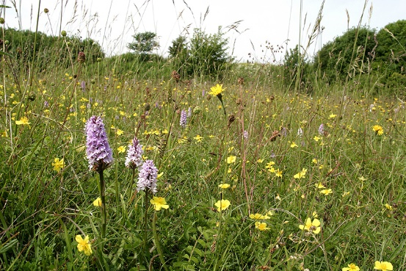
A bit about Norfolk Wildlife Trust…
We protect more than 50 nature reserves across Norfolk for wildlife and people.
Saving Norfolk’s Wildlife for the Future
Notes:
Different animals and plants need different sorts of places to live.
Photos: Richard Osbourne, Ray Jones, Tasha North, Nick Carter, Wildstock and Russel Baylin

Slide 3
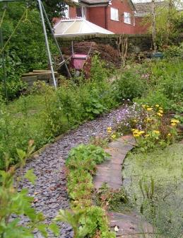
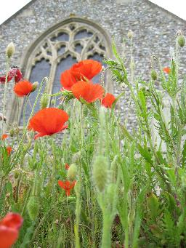
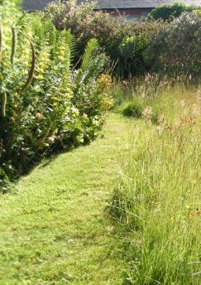
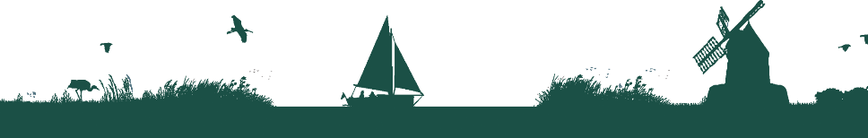
We also help to make gardens, parks, schools, churchyards, roadsides and other areas more wildlife-friendly so that nature reserves are joined up. We call this a “Living Landscape”.
Saving Norfolk’s Wildlife for the Future
Notes:
These areas aren’t immaculately tidy, which is great for wildlife. Some grass is long, there is a pond and the species are native to Britain.
Photos: Richard Burkmarr, David North, Richard Burkmarr.

Slide 4
These are words we might use during your visit. Can you work out what they are?
1) A place where plants and animals can live
H
A
B
I
T
A
T
2) An exact type of animal or plant
S
P
E
C
I
E
S
3) An area which is protected for wildlife
N
A
T
U
R
E
R
E
S
E
R
V
E
4) Something plants and animals have done over time so that they can live in their habitat
A
D
A
P
T
5) The number of different plant and animal species in an area
B
I
O
D
I
T
Y
V
E
R
S
I
6) A person who looks after a nature reserve
W
A
R
D
E
N
Saving Norfolk’s Wildlife for the Future

Slide 5
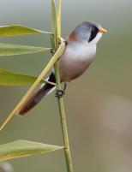
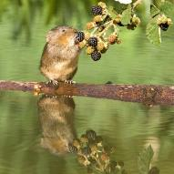
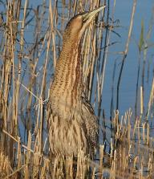
After your visit, you’ll know more about different environments and what lives in them.
We’ll find plenty of plants and some small animals but they’re all wild so what we’ll see is a mystery!
We’ll explore different habitats at Thorpe Marshes, each with its own different species
Saving Norfolk’s Wildlife for the Future
Notes:
Bearded tit (rare bird) – feet adapted for clinging onto small twigs
Water vole – rare because it needs muddy, plant-covered river banks for its burrow, not concrete! “Ratty” in “Wind in the Willows” was a water vole
Bittern (rare bird) – very well camouflaged in the reeds
Photo: Peter Mallet, Steve Bond and Ian Simons

Slide 6
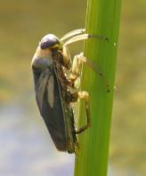
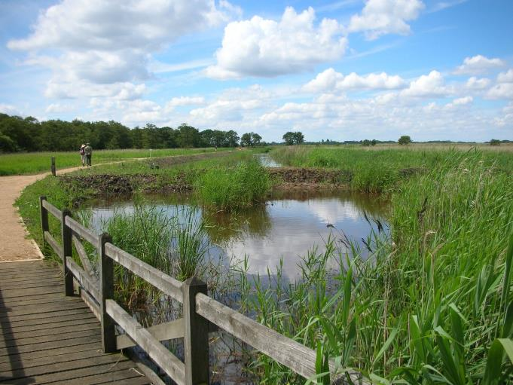
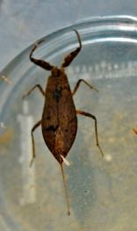
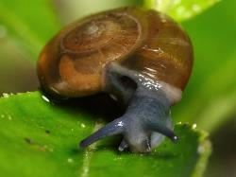
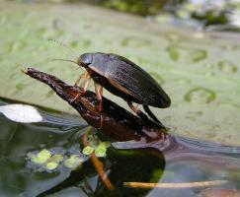
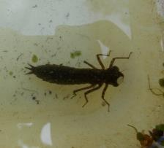
Freshwater Dyke
Saving Norfolk’s Wildlife for the Future
Notes:
Anti- Clockwise from top left: Water scorpion, dragonfly nymph, great diving beetle, ramshorn snail, greater water boatman.
Photos: Elizabeth Dack, Jamie McMillian, Brian Valentine, Richard Burkmarr and Isabelle Mudge

Slide 7
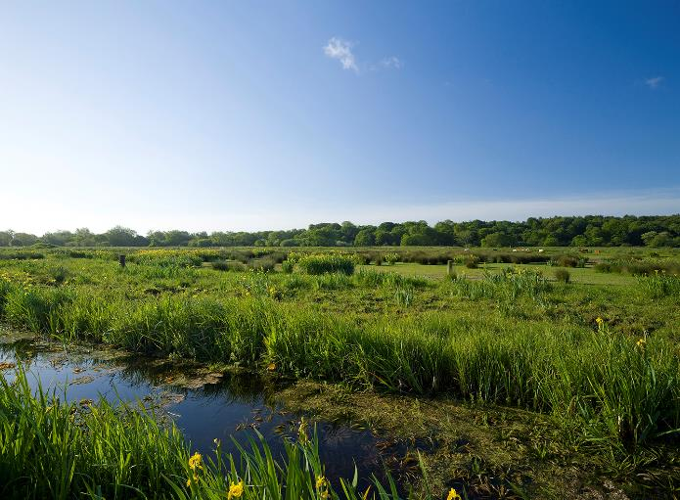
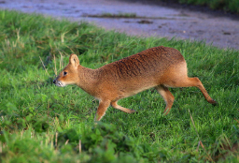
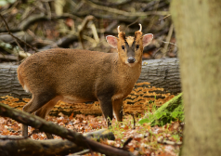
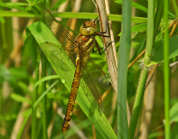
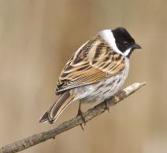
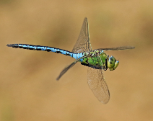
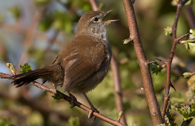
Grazing marsh
Saving Norfolk’s Wildlife for the Future
Notes:
Clockwise from top left: Muntjac deer, Chinese water deer, Norfolk hawker dragonfly, emperor dragonfly, cettis warbler, reed bunting.
Photos: Liz Dack, Tabs Taberham, Bob Carpenter, Paul Taylor, Alex Mclennan and Tom Wiley.

Slide 8
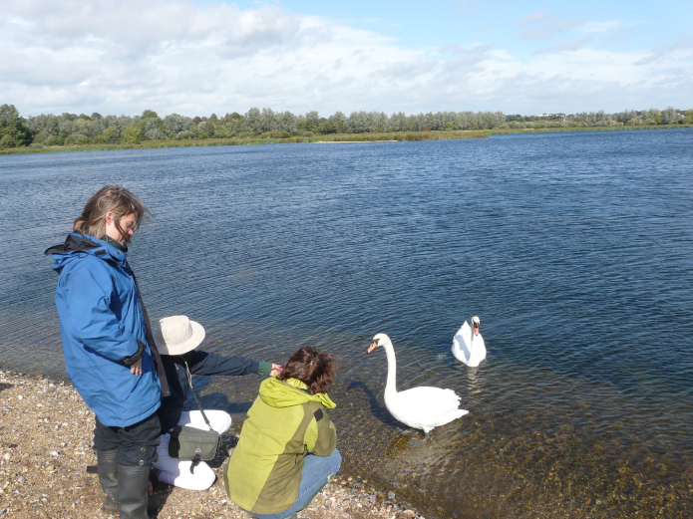
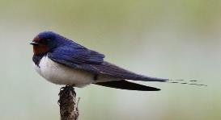
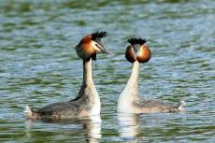
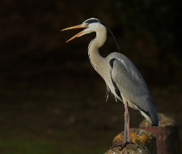
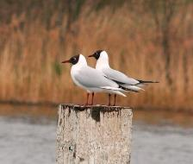
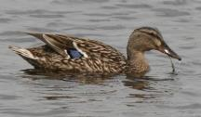
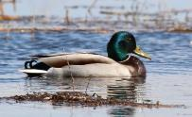
Open Water
Saving Norfolk’s Wildlife for the Future
Notes:
Clockwise from top left: Great crested grebes, swallow, grey heron, male mallard, female mallard, black headed gulls.
Photos: Peter Mallet, Elizabeth Dack, Nick Goodrun, Maurice Funnell and Robert Powell.

Slide 9
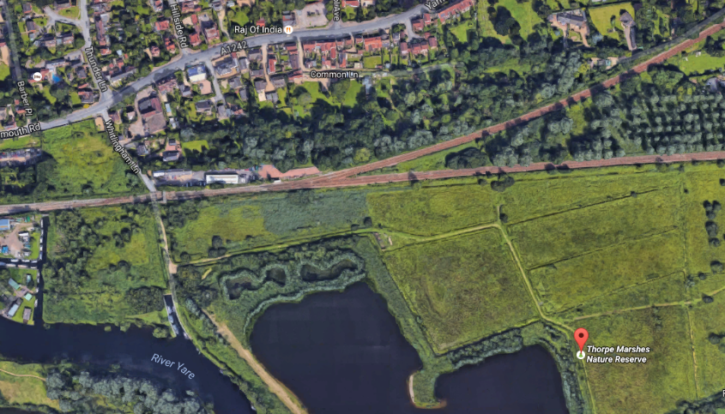
Your coach will drop you off at the footbridge next to the railway line. Unfortunately, we don’t have toilet facilities on site.
Saving Norfolk’s Wildlife for the Future

Slide 10
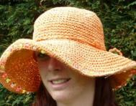
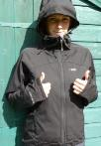


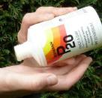
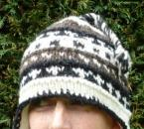
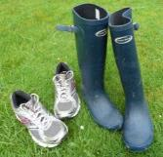
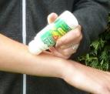
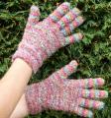
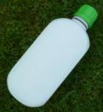
What to wear and bring
Hot and sunny weather
Whatever the weather
Cold weather
Waterproof
jacket
Sun hat
Scarf
Waterproof trousers,
quick drying trousers
or spare clothes
Sun cream
Warm
hat
A re-sealable
drink
Insect repellent
or long trousers and sleeves
Gloves
Welly boots or shoes
you can get dirty
NOT YOUR BEST SHOES!
Saving Norfolk’s Wildlife for the Future

Slide 11
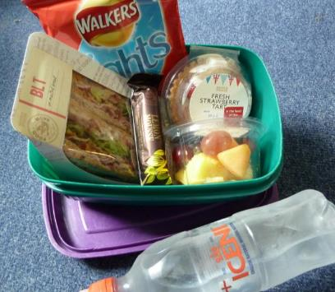
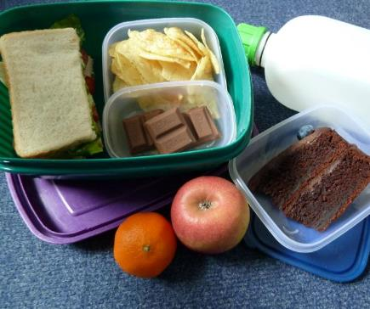
Low Impact Lunch Challenge
A ‘low impact’ lunch is one that doesn’t damage the environment much.
Compare the two lunches below, work out which is better and why
Follow our tips to see if you can make your lunch box like the low impact one.
Ask whoever does the shopping to
buy in bulk rather than
buying lots of individual bags.
This one has less packaging,
which means less rubbish.
Use reusable bottles.
Try to eat food which has not travelled too far.
Take apple cores and orange
peel home to compost.
Use reusable boxes.
Saving Norfolk’s Wildlife for the Future
Notes:
Low Impact Lunch – the photo on the right has a lower impact as there is less packaging being made for the food, which uses a lot of energy. This also means that there is less rubbish afterwards, which takes up more energy through rubbish collection services and has to be disposed of somewhere in the countryside, destroying areas of habitat and possibly causing pollution.
Home-made sandwiches and cake in reusable tubs are lower impact than shop bought, over-packaged versions - and they work out cheaper!
By buying big bags of crisps or chocolate or nuts and pouring out a day’s serving into a tub for each lunch box saves packaging – individual lunch box-sized chocolate bars or mini yoghurts or single serving bags of dried fruit produce tonnes of unnecessary waste every year.
Don’t buy pre-prepared fruit, it just creates more packaging. Instead, buy fruit as locally as possible and either take whole or prepare fruit salads at home and put into a reusable tub.
Don’t buy bottled water, tap water is fine. In Great Britain we have some of the best quality tap water in the world! Use a refillable bottle, it’s much cheaper and much, much kinder to the planet.

Slide 12
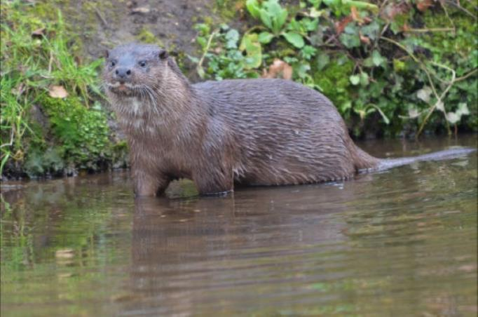
What would you like to find out
about Thorpe Marsh’s wildlife?
Can you each come up with 2 questions?
Saving Norfolk’s Wildlife for the Future
Notes:
These don’t necessarily have to be answerable.
Photo; Elizabeth Dack.

Slide 13

See you soon!
Saving Norfolk’s Wildlife for the Future
Notes:
Photo: Richard Osbourne

